Slide 1
New Mexico Indian Affairs Department Tribal Infrastructure Fund Portal Training Presented by Lawrence John
Lynn Trujillo, Cabinet Secretary Nadine Padilla, Deputy Secretary
January 21, 2022

Slide 2
Eligibility
Federally recognized Indian nation, tribe or pueblo located wholly or partially in New Mexico or any of its governmental entities or subdivisions is eligible to apply for funding

Slide 3
Tribal Infrastructure Fund Requirements
Submit a Tribal Infrastructure Fund Application through the TIF Portal
Must have a state Infrastructure Capital Improvement Plan (ICIP) number in order to apply for TIF funding
You can upload supporting documents with application in TIF Portal

Slide 4
Qualified Projects
Planning, designing, constructing, improving, expanding or equipping:
Water/wastewater facilities
Major water systems
Electrical power lines
Communications
Roads
Health infrastructure
Emergency response
Infrastructure needed to encourage economic growth

Slide 5
Project Prioritization
Emphasis is on addressing specific health, safety, welfare or economic development needs
Projects are ready to proceed within the time allotted for the grant
Demonstrated past timely expenditure and compliance with requirements for grant funding
Supported by a high percentage of funds or in-kind contribution in relation to the amount of the TIF Funding

Slide 6
One Project Per Category
Each eligible entity is limited to applying for one project within each project category in a funding cycle
Planning
=
Design
Construction

Slide 7
Funding Caps
Project Category
Amount
Planning | No Cap
Design | No Cap
Construction | 15% of the total TIF allocation available
Example: If total TIF allocation is $10 million, construction request cannot exceed 15%
($10 million x 15% = $1,500,000)
Notes:
15% of the total TIF allocation available for ALL construction projects.

Slide 8
Performance Period
Planning projects must be completed within 24 months from the date of the execution of the Intergovernmental Agreement (IGA)
Design and Construction projects must be completed within 36 months from the date of the execution of the Intergovernmental Agreement (IGA)
Extension Request must be made 60 days before date of expiration of IGA
Notes:
What about extension requests?

Slide 9
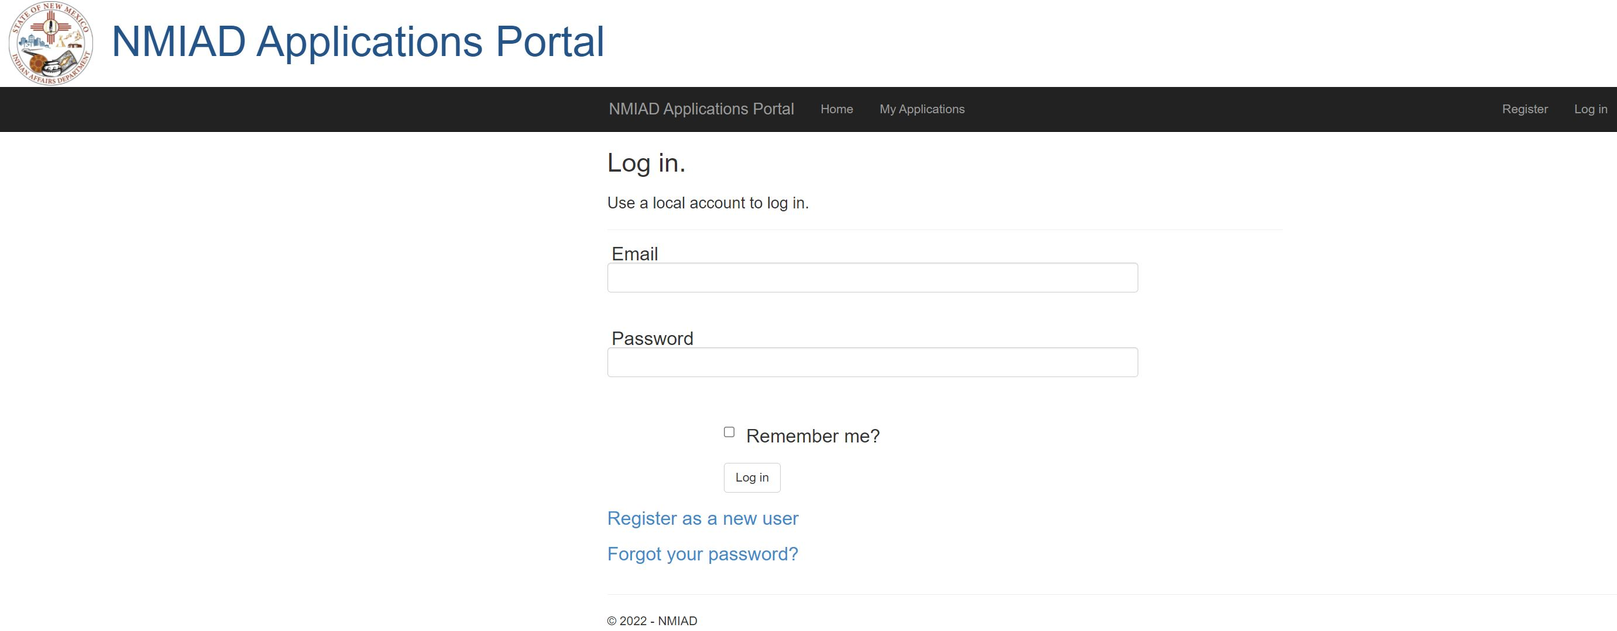
New Users – Create Account

Slide 10
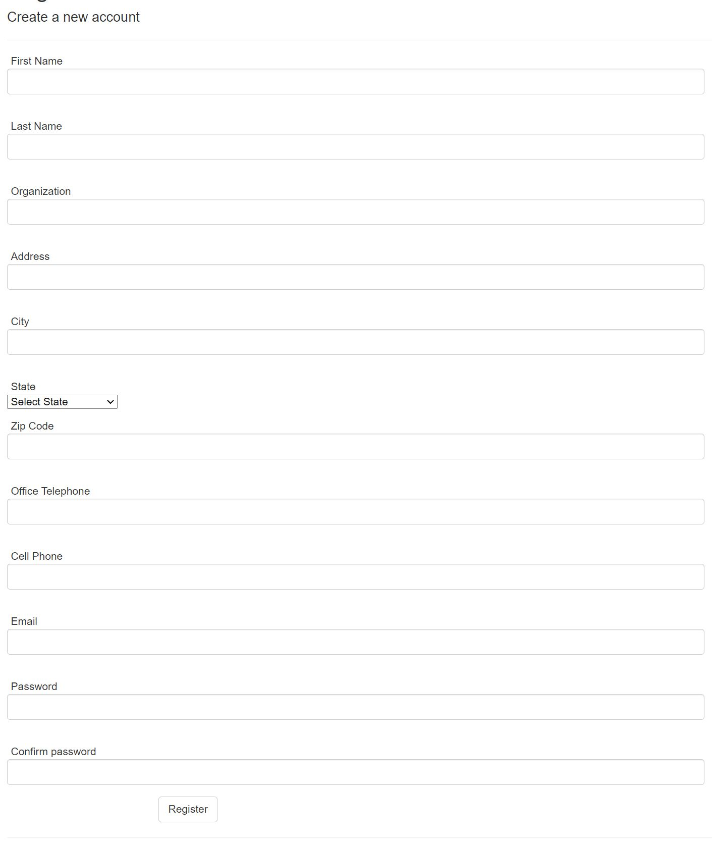
Register – New User
Notes:
If you forget your password, click the “Click here to reset your password” link. You will be prompted to enter your user name (email address). If an account with your email address exists, then you will receive an email with a link to reset the password. Click the link in your email to the change password page.
If the system does not find your email, then you will be notified that your account does not exist. If this happens, create a new account as described in the previous slide.

Slide 11
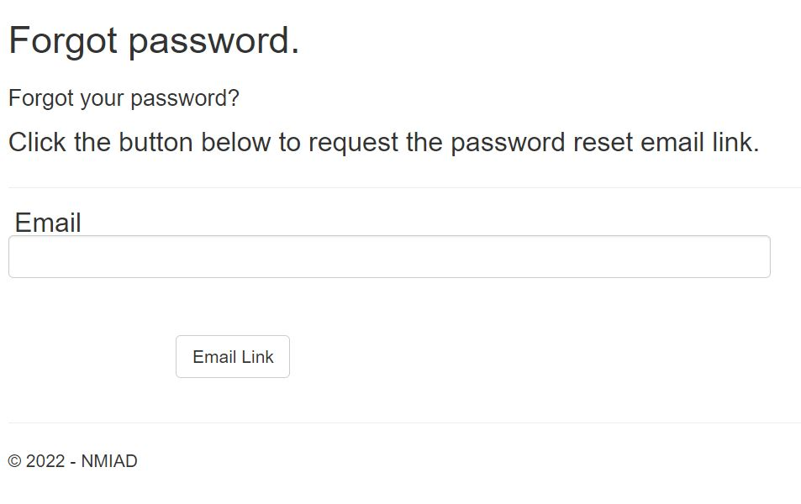
Forgot Password
Notes:
Note addition to the second declaration, “….and is included in the 2020-2024 ICIP”
An applicant should complete the both the DECLARATION and TRIBE & PROJECT INFO pages before saving. Please remind the attendees to save often.

Slide 12
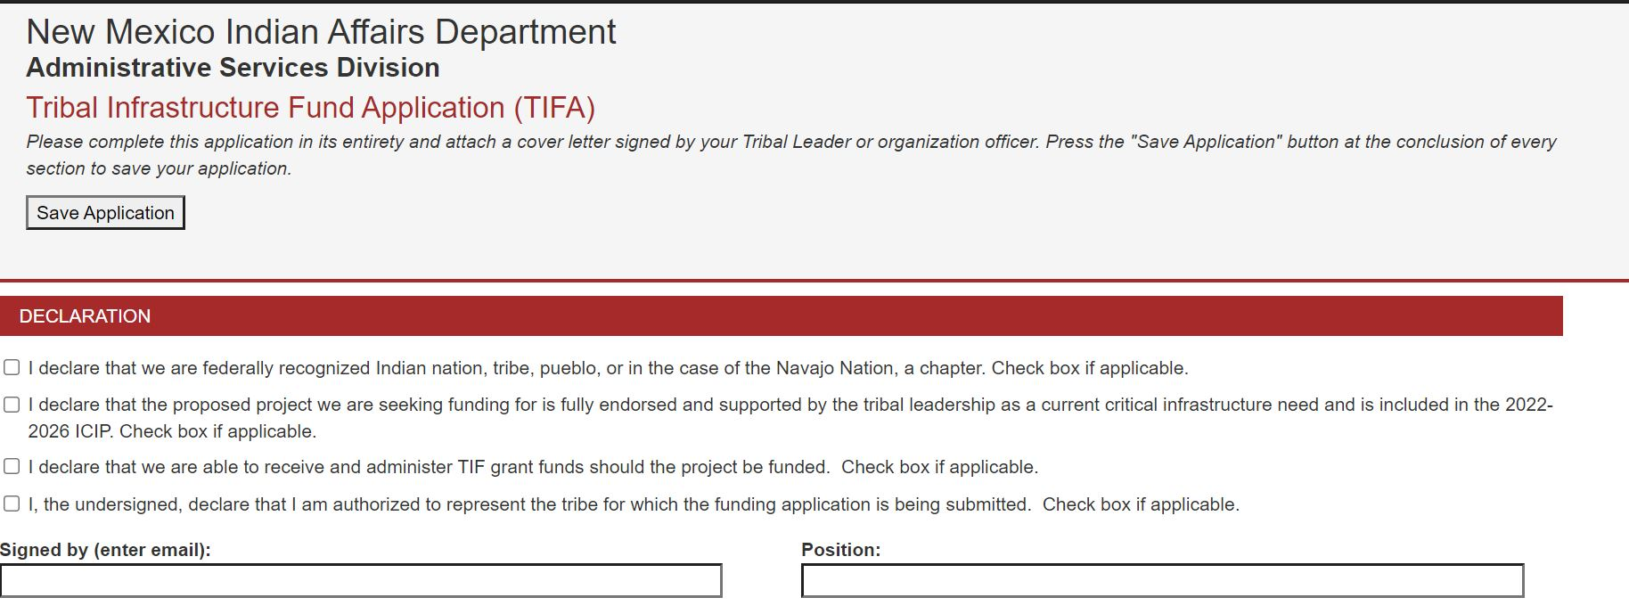
Declaration

Slide 13
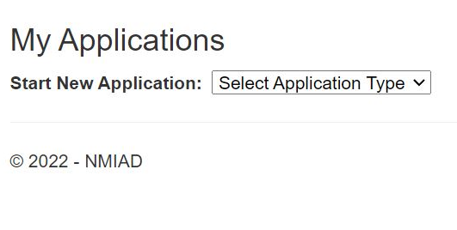
Tribe & Project Information
Click on the drop-down box and click TIF
Notes:
New to this page – uploading the ICIP list.

Slide 14
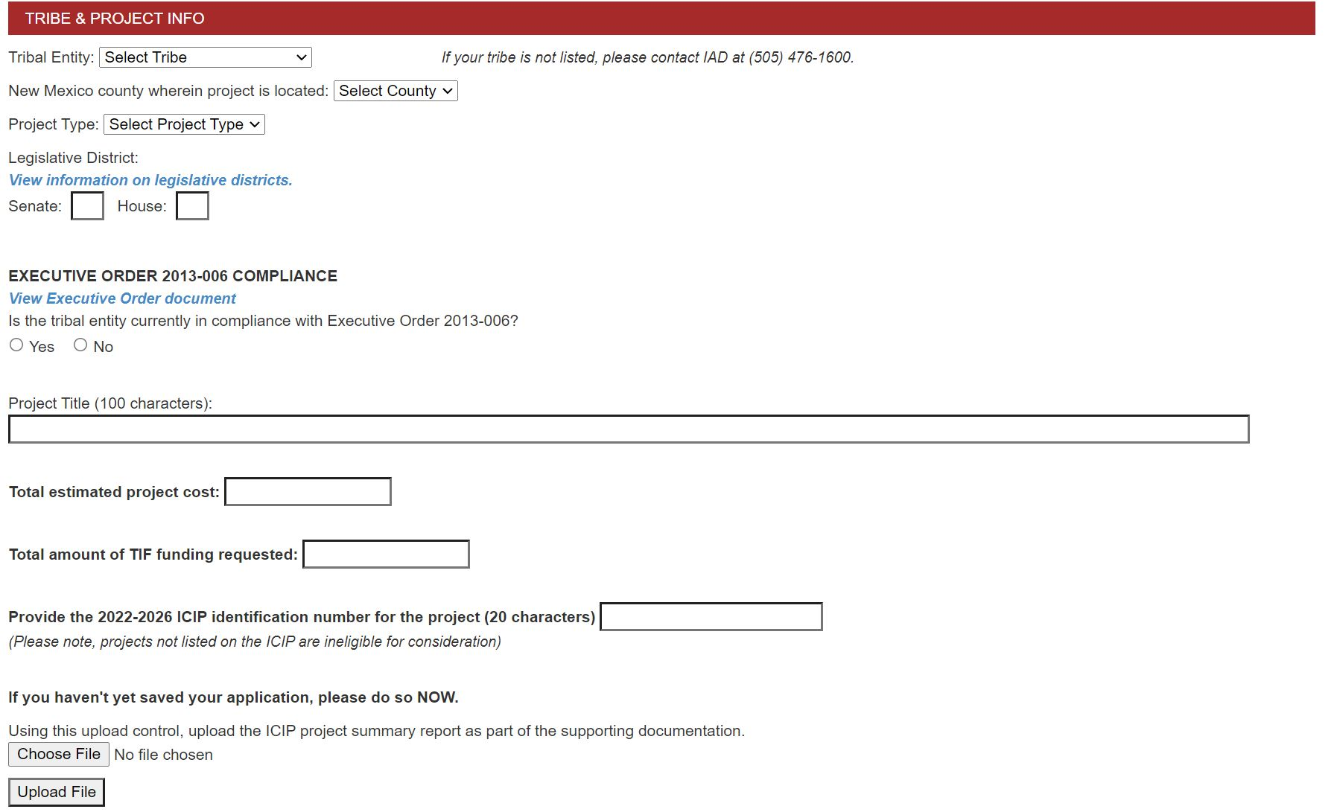
Tribe & Project Information

Slide 15
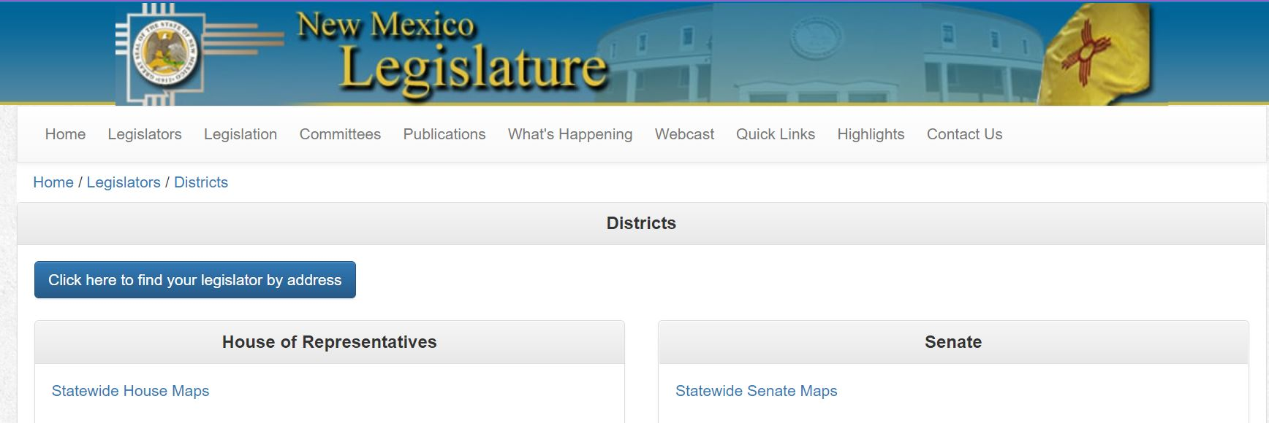
View Information on Legislative District

Slide 16
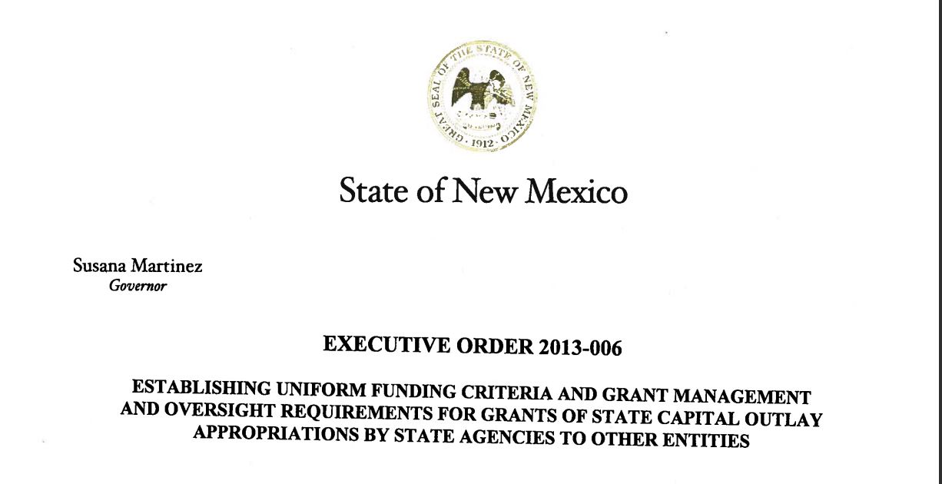
Executive Order 2013-006

Slide 17
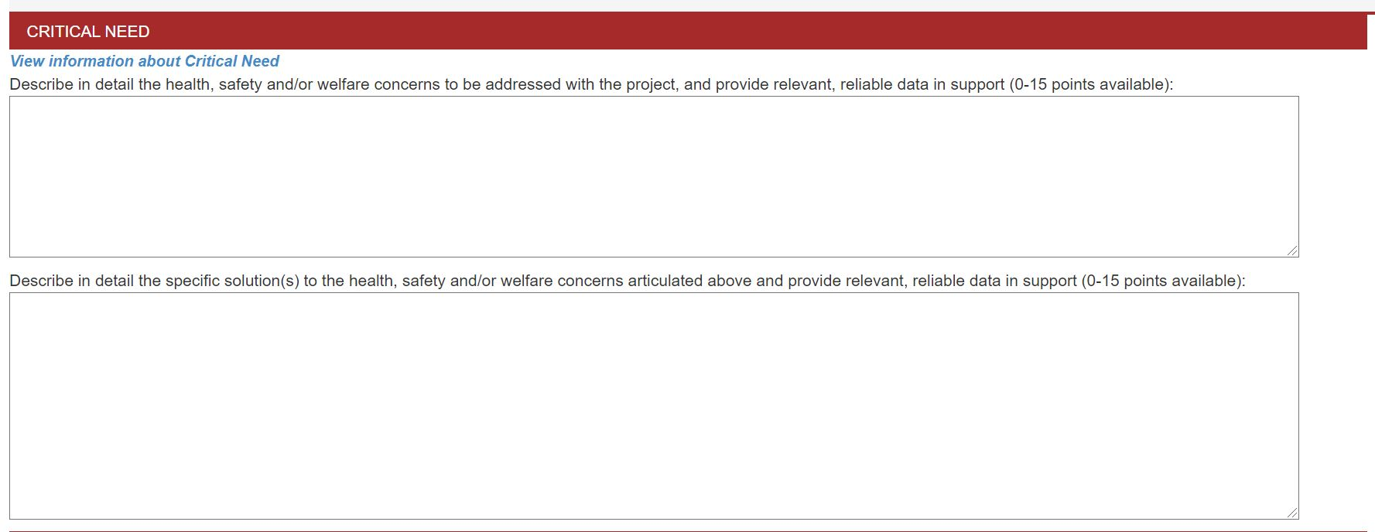
Critical Need

Slide 18
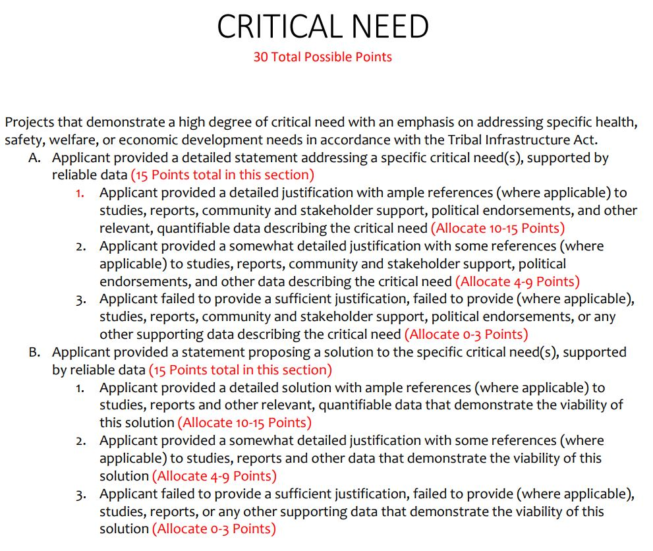
View Information about Critical Need

Slide 19
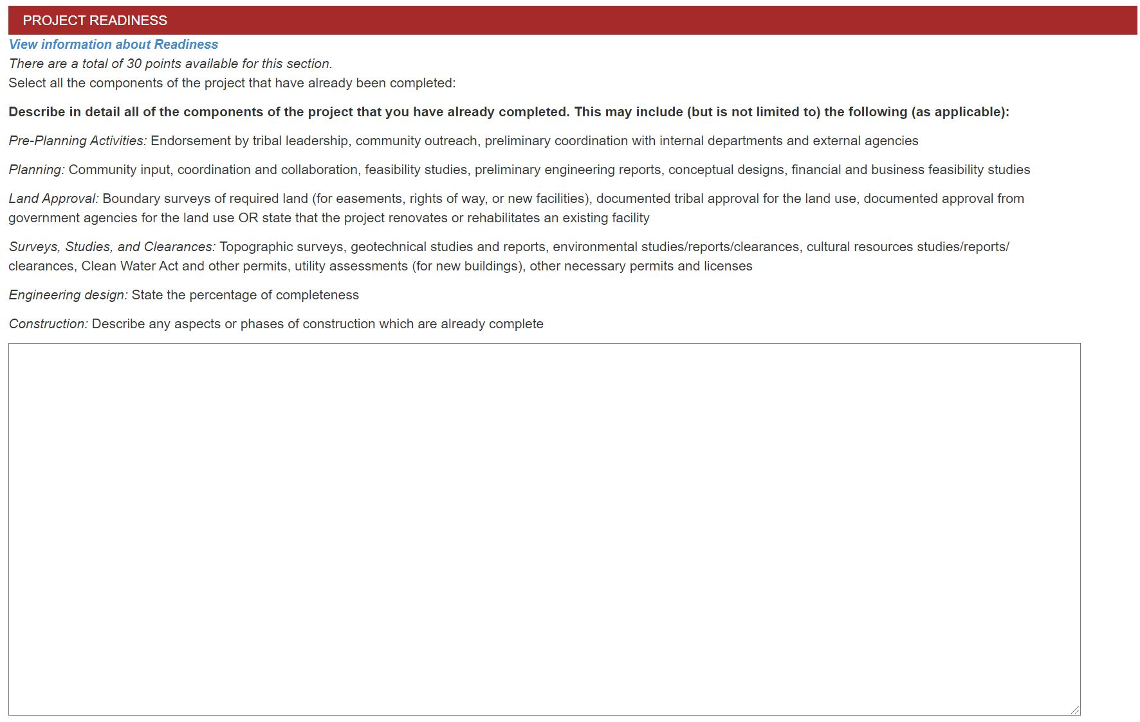
Project Readiness
Notes:
New to this page – selecting the components of the project that have already been completed.

Slide 20
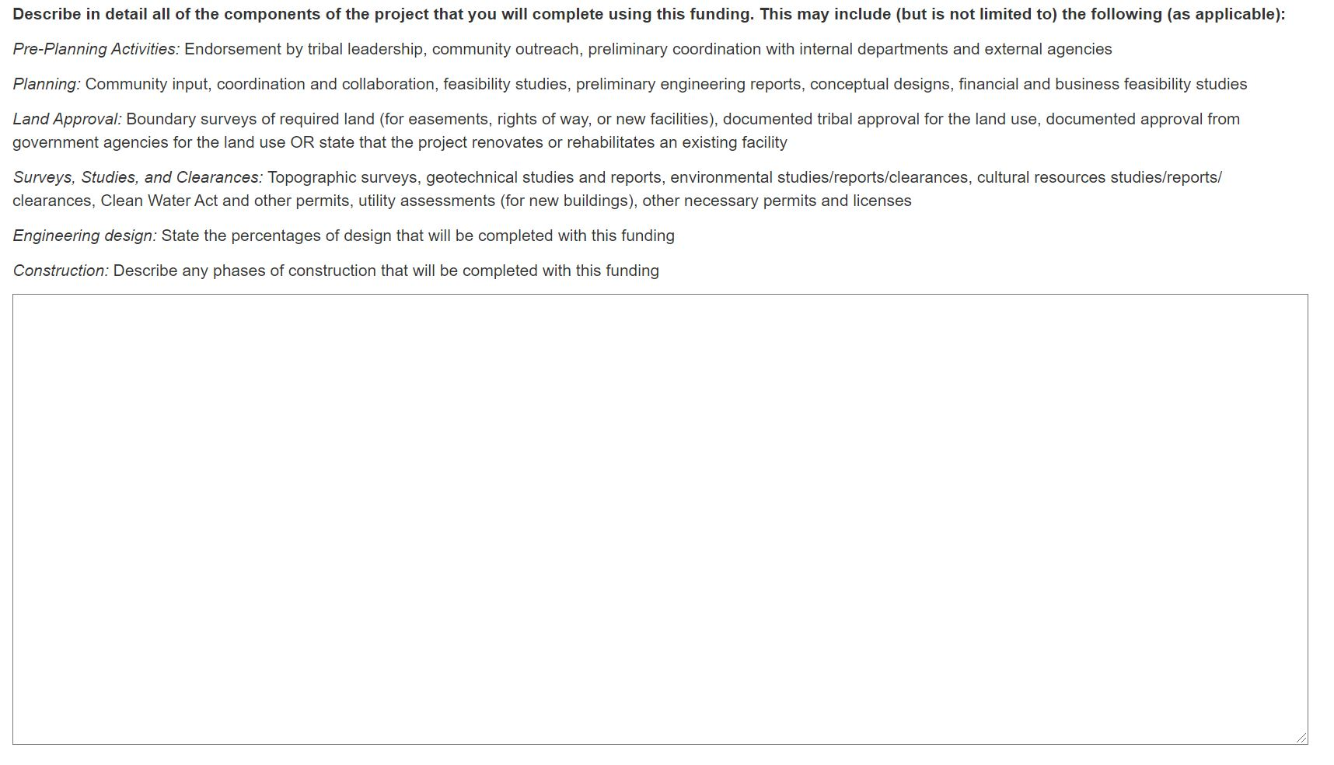
Project Readiness (cont’d)
Notes:
New to this page, adding each project component and corresponding budget amount. When a project component and budget is added to the table, the total is automatically calculated.

Slide 21
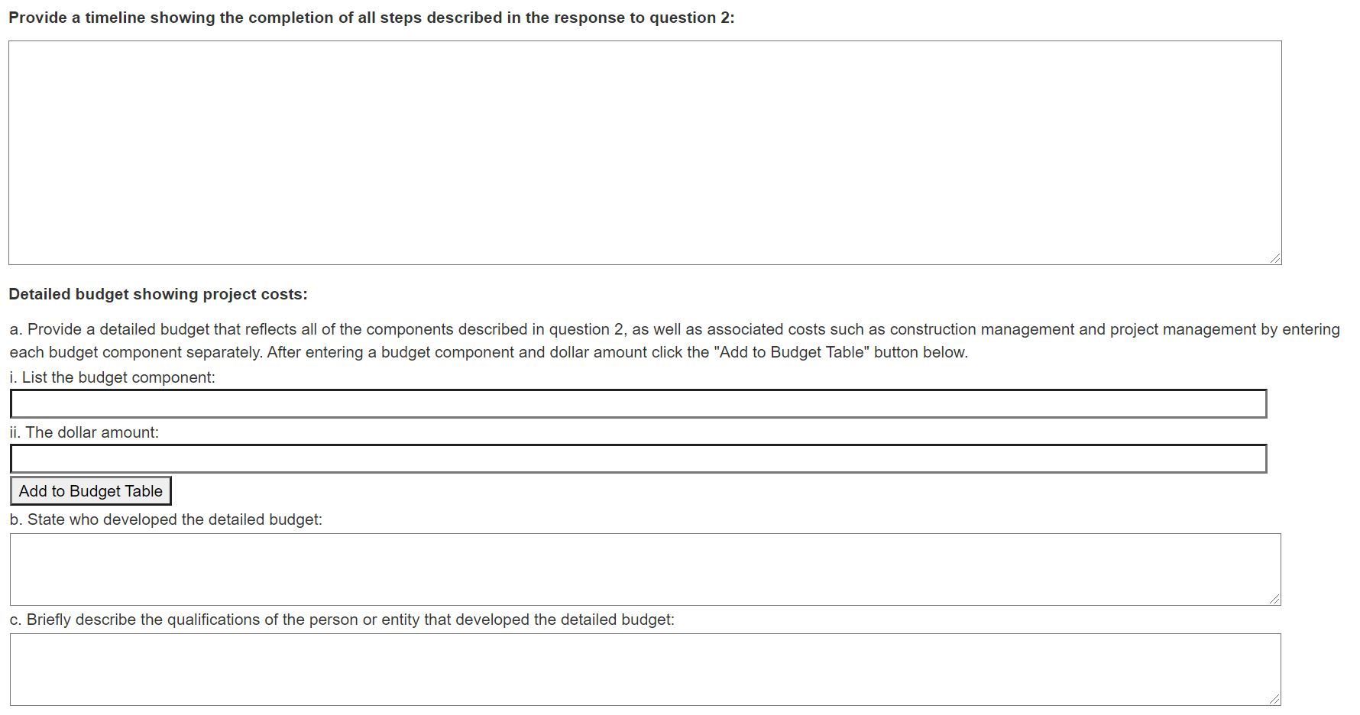
Project Readiness (cont’d)

Slide 22
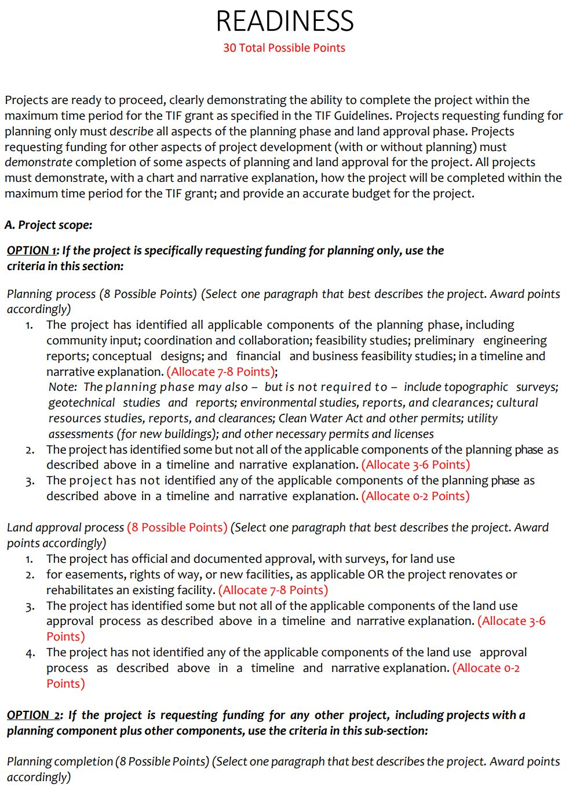
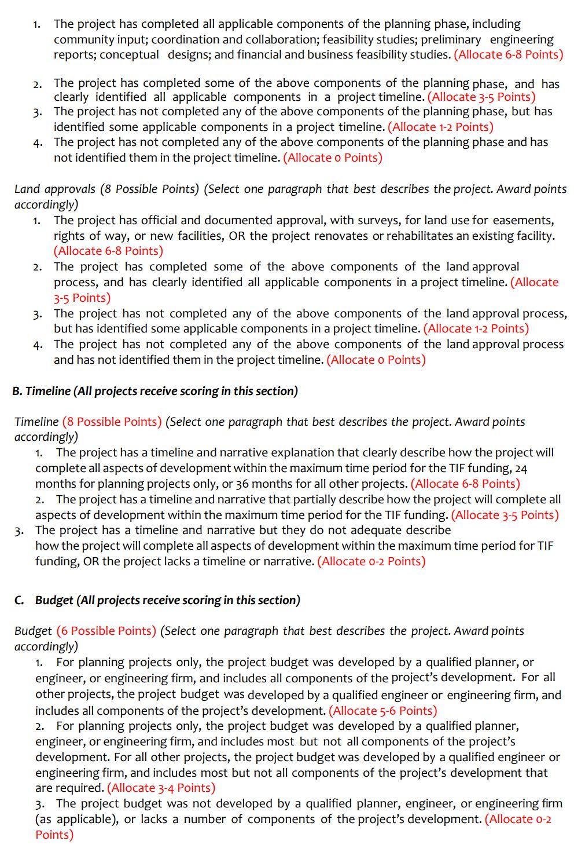
View Information about Readiness

Slide 23
Capacity
Notes:
New to this page – uploading CPMS reports

Slide 24
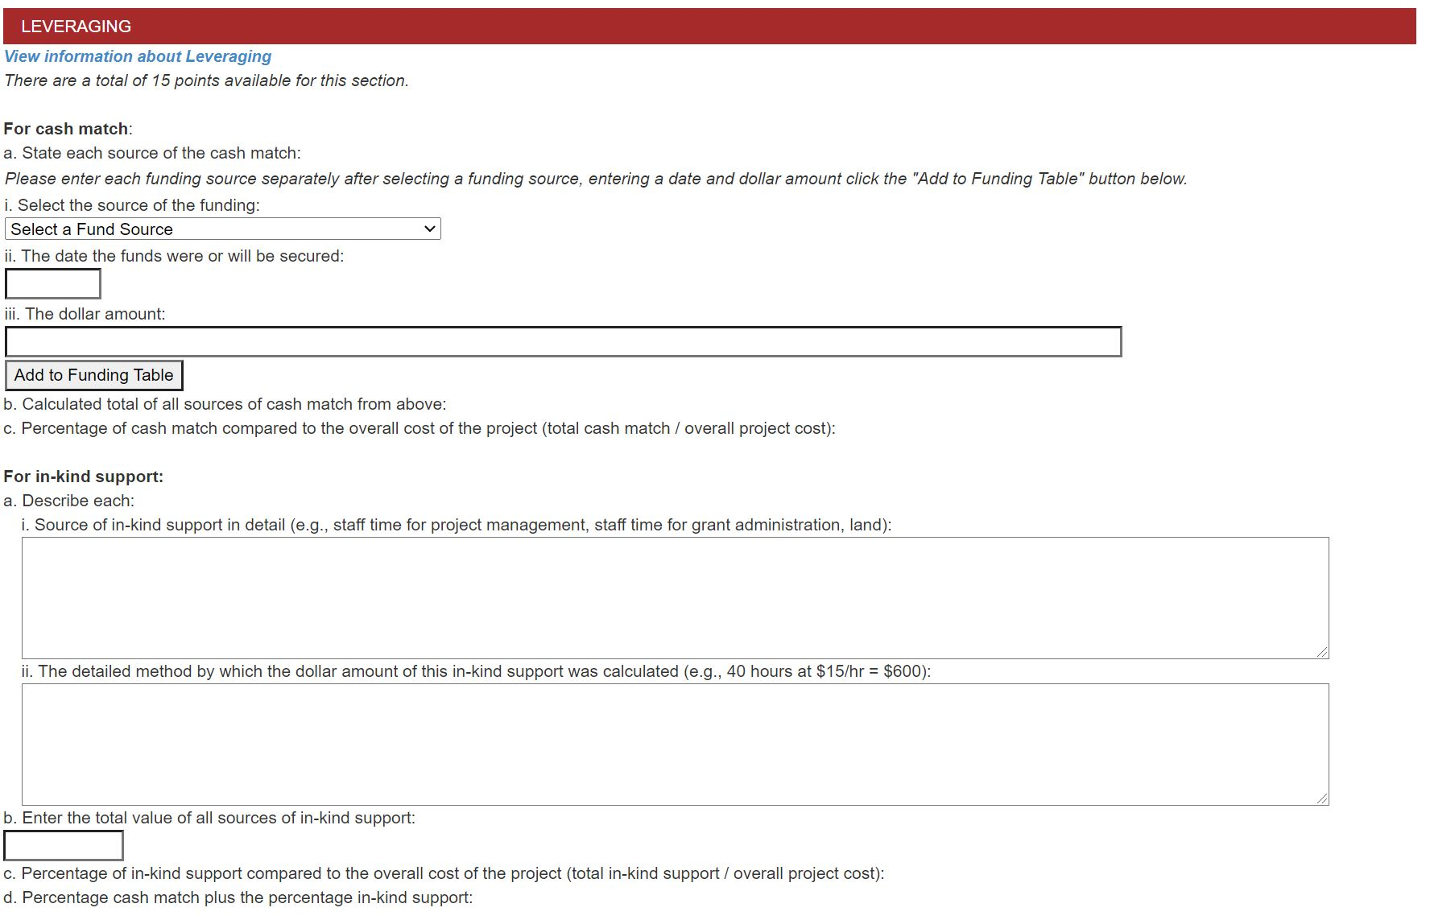
Leveraging
Notes:
Give examples of acceptable in-kind support.
New to this page – dropdown of acceptable funding sources:
NASDHA, Indian Health Service, NMFA LGPF (Local Government Project Funds), Chapter Funds, Tribal Funds, Tribal Transportation Funds, Bureau of Indian Affairs (BIA), NMDOT LGRF (Local Government Road Funds), Federal Highway Administration (FHWA), USDA-RD, CWSRF (Clean Water State Revolving Fund), New Mexico Water Trust Board (WTB), U.S. Bureau of Reclamation (USBR), Drinking Water State Revolving Loan Fund (DWSRLF), Continental Divide Electric Company (CDEC).

Slide 25
View information about Leveraging

Slide 26
Supporting Documents
Notes:
Please remind attendees to save a PDF of their application.
When they submit the application, they will receive a confirmation email.

Slide 27
Submit Application

Slide 28
Save Application

Slide 29
Reminder
Plan accordingly
Internet connection
Double check the application and attachments before submitting
Any questions please contact Lawrence
Best of Luck on your application

Slide 30
Point of Contact
Lawrence John, TIF/Capital Outlay Administrator
Lawrence.john@state.nm.us
505.690.2997
Vanessa Gutierrez, Accountant & Auditor
Vanessa.Gutierrez@state.nm.us
505.690.5694

